Slide 1


Slide 2
Margins

Slide 3
Margins
A margin is cash or marketable securities deposited by an investor with his or her broker.
Buyer or seller both have to deposit a token payment to broker and broker will deposit this money to exchange. This token money is called margin.

Slide 4

Why should there be margins?

Slide 5
Margins
Suppose a Buyer,
On January 1, 2019 - Purchases 1000 shares of ‘xyz’ company at Rs.100/-.
Then buyer has to give the purchase amount of Rs.1,00,000/- (1000 x 100) to his broker on or before next day.
Broker, in turn, has to give this money to stock exchange.

Slide 6
Margins
There is always chance that the buyer may not be able to bring the required money by required date.
Hence, buyer is required to pay a portion of Rs.1,00,000/- to the broker at the time of placing the buy order.
This initial token payment is called margin.

Slide 7


Slide 8
Remember, for every buyer there is a seller
If the buyer does not bring the money, seller may not get his / her money and vice versa.
Therefore, margin is levied on the seller also.
To ensure that seller gives the 100 shares.

Slide 9
Margin payments ensure that each investor is serious about buying or selling shares.

Slide 10

Sir!!!
Are margins same across cash and derivatives markets?

Slide 11
No!!!!!!!!!!
Shares traded on cash market are settled in two days
Whereas derivative contracts may have longer time to expiry.
Therefore, types of margins levied in the cash market segment and derivative are different

Slide 12
Cash Market

Slide 13
Cash Market Margins
Margins in the cash market segment comprise of the following three types:
Initial Margin
Value at Risk (VaR) margin
Extreme loss margin
Mark to market Margin

Slide 14
Value at Risk (VaR) margin
VaR is a technique used to estimate the probability of loss of value of a security, based on the statistical analysis.
A VaR statistic has three components:
Time period,
Confidence level
Loss amount (or loss percentage)

Slide 15
Value at Risk (VaR) margin
For example,
VaR_{1,99} = 1000
There is only 1% chance, loss this security will exceed 1000 in 1 Day.
VaR_{10,95} = 10000
There is only 5% chance, loss this security will exceed 10000 in 10 Day.

Slide 16
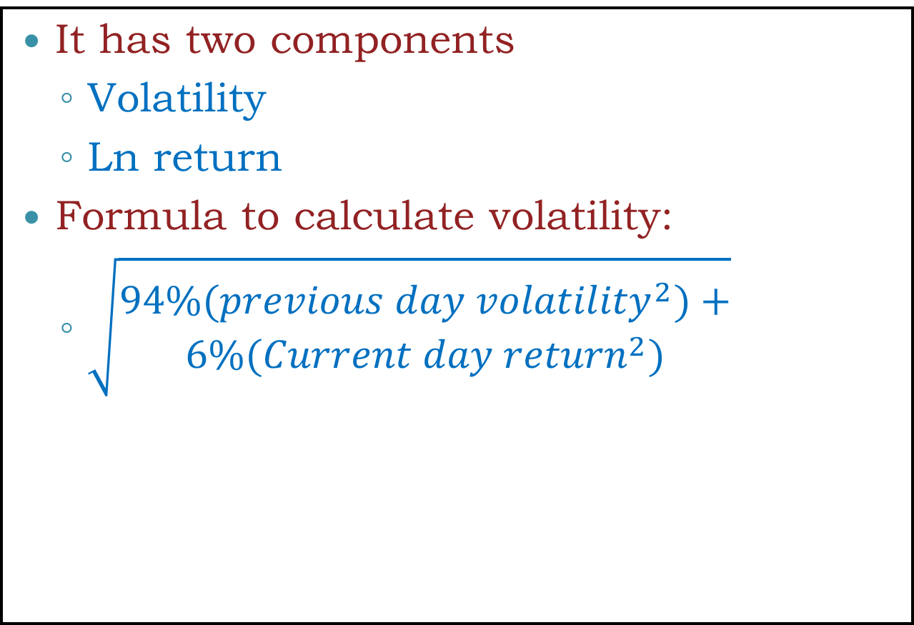
Calculation of VaR margin.
It has two components
Volatility
Ln return
Formula to calculate volatility:
$\sqrt{\begin{aligned}94\%({previous day volatility}^{2})+ \\ 6\%({Current day return}^{2})\end{aligned}}$

Slide 17
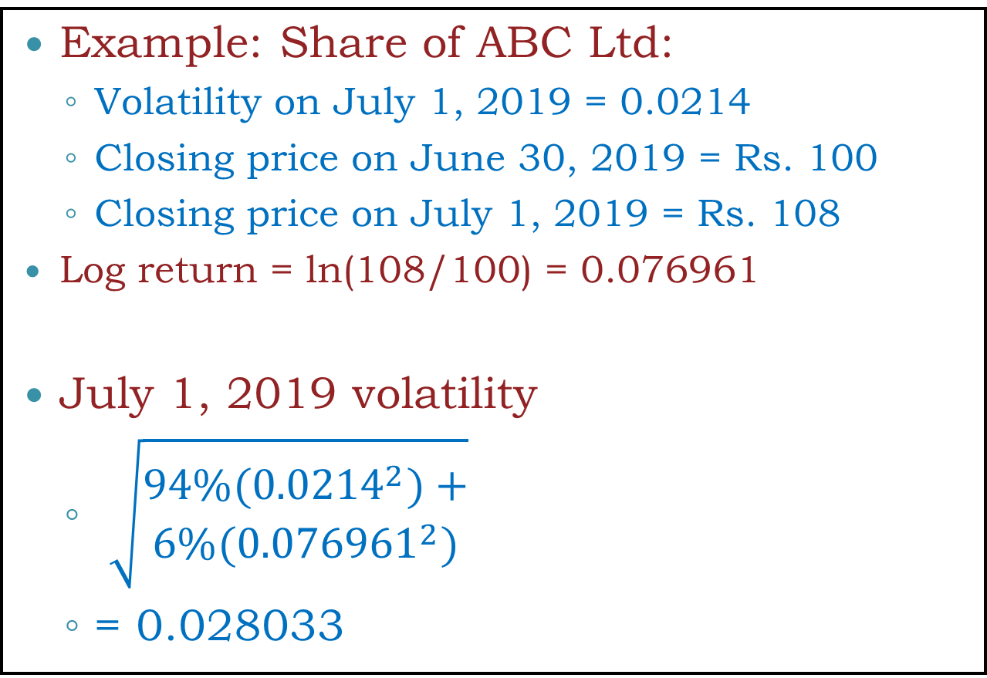
Calculation of VaR margin.
Example: Share of ABC Ltd:
Volatility on July 1, 2019 = 0.0214
Closing price on June 30, 2019 = Rs. 100
Closing price on July 1, 2019 = Rs. 108
Log return = ln(108/100) = 0.076961
July 1, 2019 volatility
$\sqrt{\begin{aligned}94\%({0.0214}^{2})+ \\ 6\%({0.076961}^{2})\end{aligned}}$
= 0.028033
This is Volatility not VaR Margin

Slide 18

Sir!!!
How to calculate Volatility?

Slide 19
Date | Price | Formulas | Value
Jul 26, 2019 | 1213.8 | =LN(B2/B3) | -0.0144770041588379
Jul 25, 2019 | 1231.5 | =LN(B3/B4) | -0.0221642414470621
Jul 24, 2019 | 1259.1 | =LN(B4/B5) | -0.0114110965178472
Jul 23, 2019 | 1273.55 | =LN(B5/B6) | -0.00544235011407788
Jul 22, 2019 | 1280.5 | =LN(B6/B7) | 0.0249073955140023
Jul 19, 2019 | 1249 | =LN(B7/B8) | -0.0102356669572542
Jul 18, 2019 | 1261.85 | =LN(B8/B9) | -0.0157254488720146
Jul 17, 2019 | 1281.85 | =LN(B9/B10) | -0.00866075281701096
Jul 16, 2019 | 1293 | =LN(B10/B11) | 0.013156548031927
Jul 15, 2019 | 1276.1 | =LN(B11/B12) | -0.0034420748996494
Jul 12, 2019 | 1280.5 | =LN(B12/B13) | -0.000819656180625368
Jul 11, 2019 | 1281.55 | =LN(B13/B14) | 0.00210904624341277
Jul 10, 2019 | 1278.85 | =LN(B14/B15) | -0.000976963285271456
Jul 09, 2019 | 1280.1 | =LN(B15/B16) | 0.0221559918972086
Jul 08, 2019 | 1252.05 | =LN(B16/B17) | -0.00898471496862236
Jul 05, 2019 | 1263.35 | =LN(B17/B18) | -0.0162132823164288
Jul 04, 2019 | 1284 | =LN(B18/B19) | 0.0011299216101542
Jul 03, 2019 | 1282.55 | =LN(B19/B20) | 0.00316276790851098
Jul 02, 2019 | 1278.5 | =LN(B20/B21) | 0.00757653731310811
Jul 01, 2019 | 1268.85 | =LN(B21/B22) | 0.0124904972468938
Jun 28, 2019 | 1253.1 | =STDEV.P(C2:C21) | 0.0124650402372948

Slide 20
Value at Risk (VaR) margin
To Calculate at VaR margin rate, companies are divided into 3 categories based on
Shares trade
Liquidity
How much a large buy or sell order changes the price of the scrip, what is technically called ‘impact cost’.

Slide 21
Value at Risk (VaR) margin
These 3 categories are:
Group 1
Regularly traded (more than 80% of the trading days in the previous six months)
High liquidity (Impact cost less than 1%)
Group 2
Regularly traded (more than 80% of the trading days in the previous six months)
Moderate liquidity (Impact cost more than 1%)
Group 3
All other shares

Slide 22
Value at Risk (VaR) margin for group 1 shares
Group 1, the VaR margin rate would be higher of
3.5 times volatility or
7.5%
For example,
Volatility was 0.028033% or 2.8033 (in our example, slide 21)
3.5*2.8033 = 9.81155%

Slide 23
Value at Risk (VaR) margin for group 2 shares
Group 2, the VaR margin rate would be
First higher of
3.5 times volatility x 1.732051
3.0 times volatility of index (minimum value of volatility of index is taken as 0.05%) x 1.732051
For example, margin rate for group 2 shares will be
3.5*2.8033*1.732051 = 16.9941%

Slide 24
Value at Risk (VaR) margin for group 3 shares
Group 3, the VaR margin rate would be
5 times Index volatility x 1.732051
For example, Then rate for group 3 shares will be
5*5*1.732051 = 43.30%

Slide 25
Calculation of Extreme Loss Margin
The extreme loss margin aims at covering the losses that could occur outside the coverage of VaR margins.
The Extreme loss margin for any stock is higher of 1.5 times the standard deviation of daily LN returns of the stock price in the last six months or 5% of the value of the position.

Slide 26
Calculation of Extreme Loss Margin
Suppose standard deviation of daily LN returns of the a stock in the last six months is 3%
Then Extreme loss Margin will be
1.5*3 = 4.5%
Then exchange will take it 5%.

Slide 27
Calculation Mark-to-Market (MTM) margin
In securities trading, Each security price is recorded based on the current market value rather than book value.
This is done most often in futures accounts to ensure that margin requirements are being met.
MTM is the P/L calculated at the end of the day on all open positions. Amount require to deposit w.r.t MTM is called as MTM margin.

Slide 28
MTM margin
Suppose,
A buyer purchased 1000 shares @ Rs.100/- on July 1, 2019.
Initial Margin was 22% (VaR+ELM) =22000
If Share close at Rs.75/-, then the buyer faces a notional loss of Rs.75,000.
In such case, chance that the buyer may not be able to bring the required money by required date.
Hence, MTM margin is required.

Slide 29
Example of a Futures Trade
An investor takes a long position in 2 December gold futures contracts on June 5
Contract size is 100 oz.
Futures price is US$400/oz
Margin requirement is US$2,000/contract (US$4,000 in total)
Maintenance margin is US$1,500/contract (US$3,000 in total)

Slide 30
Example of a Futures Trade
Total margin requirement
= 2 x 2000 = $ 4000
Maintenance margin requirement
= 2 x 1000 = $ 3000
Suppose the price goes down to 397 the next day
Loss = (397-400) x 2 x 100 = (600)

Slide 32


That’s all for the DAY!!!

